Slide 1

Intro To Angular
Notes:
I am here to tell you about the State of Angular
Angular is a framework designed to support developers as they build scalable Web applications.
Whether it's scaling your product as user-demand increases or scaling your team to meet the growing technical needs, Angular has been there and will continue to be there for you and your teams.

Slide 2
What’s SPA?
Notes:
The Angular team has been hard at work delivering great features to support developers all over the world building scalable, performant applications.
Recently, they’ve completed some major projects that we’ll talk more about, so let's get started..

Slide 3



Notes:
Thank you!

Slide 4
Typescript
Notes:
Speaking of which, let's talk about where Angular is going next.
In order to serve the most developers, the team have to create a simpler, more frictionless Angular for existing developers and those new to the framework.

Slide 5
Angular directive?
Notes:
I am here to tell you about the State of Angular
Angular is a framework designed to support developers as they build scalable Web applications.
Whether it's scaling your product as user-demand increases or scaling your team to meet the growing technical needs, Angular has been there and will continue to be there for you and your teams.

Slide 6
Component
structure
Attribute
Notes:
Thank you!

Slide 7
Angular component?
Notes:
Speaking of which, let's talk about where Angular is going next.
In order to serve the most developers, the team have to create a simpler, more frictionless Angular for existing developers and those new to the framework.

Slide 8
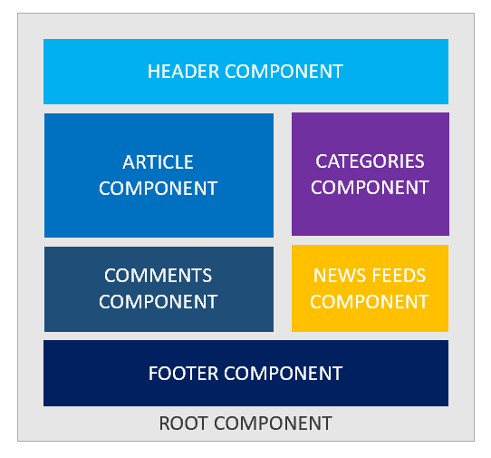
Notes:
Thank you!

Slide 9
Angular structure directive?
Notes:
I am here to tell you about the State of Angular
Angular is a framework designed to support developers as they build scalable Web applications.
Whether it's scaling your product as user-demand increases or scaling your team to meet the growing technical needs, Angular has been there and will continue to be there for you and your teams.

Slide 10
NgIf NgSwitch NgFor
Notes:
Thank you!

Slide 11
Angular attribute directive?
Notes:
The Angular team has been hard at work delivering great features to support developers all over the world building scalable, performant applications.
Recently, they’ve completed some major projects that we’ll talk more about, so let's get started..

Slide 12
NgClass NgStyle NgModel
Notes:
Thank you!

Slide 13
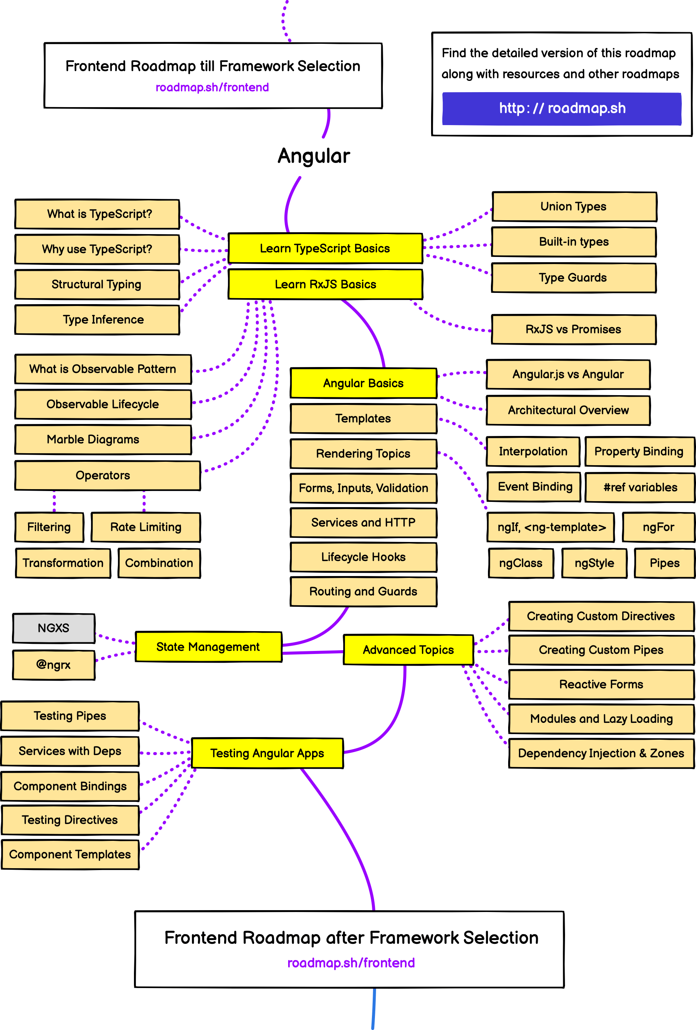
Notes:
The Angular team has been hard at work delivering great features to support developers all over the world building scalable, performant applications.
Recently, they’ve completed some major projects that we’ll talk more about, so let's get started..

Slide 14

Notes:
The Angular team has been hard at work delivering great features to support developers all over the world building scalable, performant applications.
Recently, they’ve completed some major projects that we’ll talk more about, so let's get started..

Slide 15
What’s PWA?
Notes:
The Angular team has been hard at work delivering great features to support developers all over the world building scalable, performant applications.
Recently, they’ve completed some major projects that we’ll talk more about, so let's get started..

Slide 16

Notes:
Thank you!

Slide 17

Thank You!
Mohamed Amr
@devmohamedamr
Notes:
Thank you!

